Slide 1
Rights of these slides are reserved to PF Team as mentioned in the lecture by Dr. Awais ☺

Slide 2

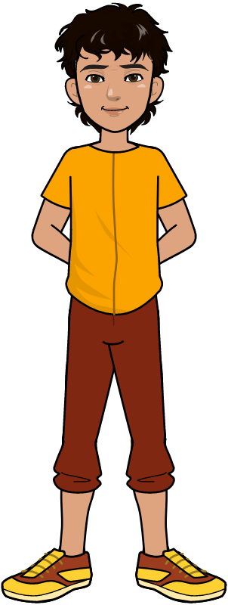
Conditional Statements In Python

Slide 3

Learning Objectives
Define why we need Conditional Statements.
Define the conditional structure
Define and understanding of comparison operator
Define and understanding IF, IF ELSE and IF ELIF
Computer Science Department, UET Lahore.

Slide 4

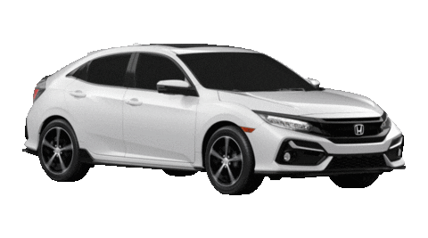
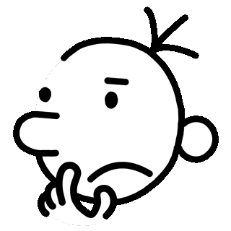
Why do we need Conditions? (Why)
When we add some kind of condition on some task, this is called conditional statement.
If I had the Money, I would buy a Car
Computer Science Department, UET Lahore.

Slide 5


Why do we need Conditions?
We speak many Conditional Statements daily in our life.
If there will be Good Weather then we will go on Picnic.
Computer Science Department, UET Lahore.

Slide 6

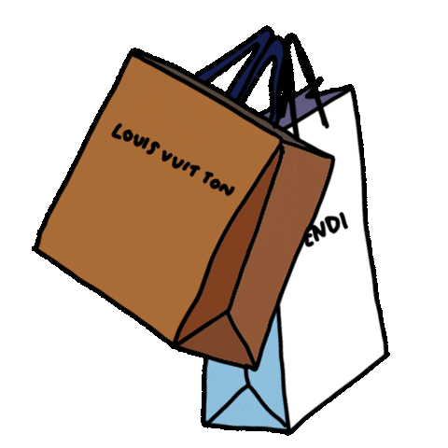
Why do we need Conditions?
We speak many Conditional Statements daily in our life.
If there will be no Rain, then we will go to Market
Computer Science Department, UET Lahore.

Slide 7


Why do we need Conditions?
We speak many Conditional Statements daily in our life.
If it will be a Sunny Day, then we will go to play Football.
Computer Science Department, UET Lahore.

Slide 8

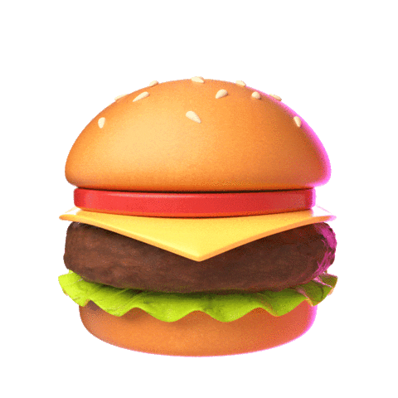
Why do we need Conditions?
We speak many Conditional Statements daily in our life.
If you do my homework then i will offer you a Burger.
Computer Science Department, UET Lahore.

Slide 9

Why do we need Conditions?
As Programming solves Real World problems; therefore, it also needs the Conditional Statements.
Computer Science Department, UET Lahore.

Slide 10
Review: Input/Output in Python
Before understanding Conditional Statements in Programming, let’s Practice taking Input and displaying Output which we have already learned in previous week.
Computer Science Department, UET Lahore.

Slide 11
Review: Input/Output in Python
Write a Program, that takes name as Input, and Prints Welcome with the Name.
Computer Science Department, UET Lahore.

Slide 12

Review: Input/Output in Python
Write a Program, that takes name as Input, and Prints Welcome with the Name.
Computer Science Department, UET Lahore.

Slide 13
Review: Input/Output in Python
Now, we want to make changes in the following Program so it prints Welcome with name only when the name is Ahmad.
Computer Science Department, UET Lahore.

Slide 14

IF Statement (How)
Now, we want to make changes in the following Program so it prints Welcome with name only when the name is Ahmad.
Computer Science Department, UET Lahore.

Slide 15
IF Statement (How)
This is a conditional statement. IF statement has following two parts
IF statement
Body of IF statement
If Statement
Computer Science Department, UET Lahore.

Slide 16
IF Statement (How)
This is a conditional statement. IF statement has following two parts
IF statement
Body of IF statement
Comparison
Operator
Value
Variable
Reserved
Word
Computer Science Department, UET Lahore.

Slide 17
IF Statement: Boolean Expression
This is a conditional statement. IF statement has following two parts
IF statement
Body of IF statement
Boolean Expression
Computer Science Department, UET Lahore.

Slide 18
IF Statement: Equal Comparison Operator
This is a conditional statement. IF statement has following two parts
IF statement
Body of IF statement
Equal (==)
Comparison Operator
Computer Science Department, UET Lahore.

Slide 19
IF Statement: What Updates?
What if we want to always print Welcome with name when the name is not Ahmad.
Computer Science Department, UET Lahore.

Slide 20

IF Statement: Not Equal Comparison Operator
What if we want to always print Welcome with name when the name is not Ahmad.
Not Equal (!=) Comparison Operator
Computer Science Department, UET Lahore.

Slide 21
Comparison Operators
Other than Equal (==) and not Equal to (!=) there are many comparison Operators.
Computer Science Department, UET Lahore.

Slide 22
Comparison Operators list
Comparison Operators | Description | Applicable on | Example
== | Equal to | Textual Data Numeric Data | if ( “AB” == “AC”) if (5 == 5)
!= | Not equal to | Textual Data Numeric Data | if (“AB” != “AC”) if ( 5 != 3 )
< | Less than | Numeric Data | if ( 2 > 4 )
> | Greater Than | Numeric Data | if ( 4 < 4 )
<= | Less than or equal to | Numeric Data | if ( 5 <= 90 )
>= | Greater than or equal to | Numeric Data | if ( 66 >= 21 )
Computer Science Department, UET Lahore.

Slide 23

Working Example (Reinforcing with Example)
Write a program that takes marks of one subject from the user. If marks are more than 50 it displays “You passed” and “Program ends” and if marks are lesser than 50 it displays only “Program ends”.
Computer Science Department, UET Lahore.

Slide 24


Expected Outputs
If user enters less than 50
If user enters greater than 50
Computer Science Department, UET Lahore.

Slide 25

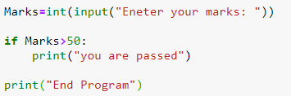
Solution: IF Condition
Data type
Condition
Computer Science Department, UET Lahore.

Slide 26
Working Example (Reinforcing with Example)
Write a program that takes marks of one subject from the user. If marks are more than 50 it displays “You passed” and else it displays “You are fail”.
Computer Science Department, UET Lahore.

Slide 27


Expected Outputs
If user enters less than 50
If user enters greater than 50
Computer Science Department, UET Lahore.

Slide 28
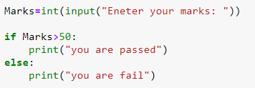
Solution: IF ELSE Condition
Computer Science Department, UET Lahore.

Slide 29
Working Example (Reinforcing with Example)
Write a program that takes marks of one subject from the user. If marks are more than or equal to 50 it displays “You passed”, ELIF it displays “You are fail” and ELSE “Enter Valid Number”
Computer Science Department, UET Lahore.

Slide 30

Expected Outputs
If user enters less than 50
If user enters greater than 50
If user enters Wrong Number
Computer Science Department, UET Lahore.

Slide 31
Logical operators
OPERATOR | DESCRIPTION | SYNTAX
and | Logical AND: True if both the operands are true | x and y
or | Logical OR: True if either of the operands is true | x or y
not | Logical NOT: True if operand is false | not x
Computer Science Department, UET Lahore.

Slide 32
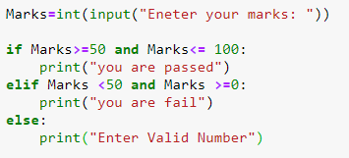
Solution: IF ELIF & ELSE Condition
Logical
Operation
Computer Science Department, UET Lahore.

Slide 33

Learning Objective
In this lecture, we learnt how to write a Python program for conditional statements with a single Boolean expression consisting of a comparison operator.
Computer Science Department, UET Lahore.

Slide 34

Conclusion
To achieve decision making in programming, conditional structure is used.
With the help of comparison operator we can compare values.
A condition is also called a Boolean expression.
Computer Science Department, UET Lahore.

Slide 35
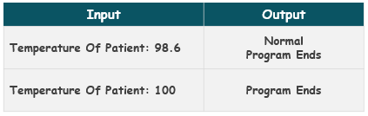
Self Assessment
Solve the Following Programs
1. Write a program that takes the temperature of a patient in Fahrenheit as input and prints “Normal” if the temperature is equal to 98.6
Test Cases
Computer Science Department, UET Lahore.

Slide 36
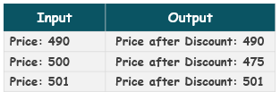
Self Assessment
Solve the Following Programs
2. Write a Program that takes the total price of the items bought by a customer. If the price is exactly equal to 500$ then it gives an overall 5% discount to the customer and displays the updated price.
Test Cases
Computer Science Department, UET Lahore.

Slide 37
Self Assessment
Solve the Following Programs
3. Write a program which takes a number as input from the user. If the number is more than 200 it asks the user to enter 4 more numbers and displays the sum of the first 2 numbers and multiplication of the last 2 numbers on separate lines.
Computer Science Department, UET Lahore.

Slide 38
Self Assessment
Solve the Following Programs
4. Write a program which takes a number from the user if the number is not equal to 200, it asks the user to enter 4 more numbers and displays the result after subtracting the first 2 numbers and dividing the last 2 numbers.
Computer Science Department, UET Lahore.

